Slide 1

Reinforcement Learning Q - Learning

Slide 2
Contents
What is Q-Learning
RL Agent-Environment
Use of Bellman Equation in Q-Learning
Use of Markov Decision Process
Important terms in Q-Learning
Q-Learning concept
What’s a Q-Table
Example
Steps to create Q-Table
Implementation using python
References

Slide 3
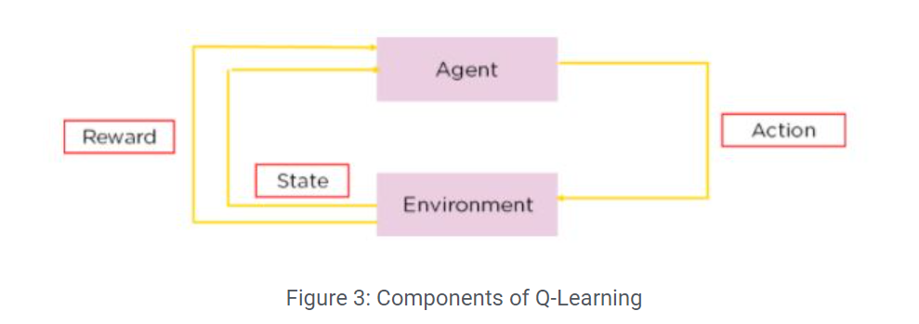
What is Q learning?
The ‘q’ in q-learning stands for quality. Quality in this case represents how useful a given action is in gaining some future reward.
Q-Learning is a Reinforcement learning policy that will find the next best action, given a current state. It chooses this action at random and aims to maximize the reward.

Slide 4
What is Q learning?
Q-learning is a model-free, off-policy reinforcement learning that will find the best course of action, given the current state of the agent. Depending on where the agent is in the environment, it will decide the next action to be taken.
The objective of the model is to find the best course of action given its current state. To do this, it may come up with rules of its own or it may operate outside the policy given to it to follow. This means that there is no actual need for a policy, hence we call it off-policy.
Model-free means that the agent uses predictions of the environment’s expected response to move forward. It does not use the reward system to learn, but rather, trial and error.

Slide 5
What is Q learning?
Example of Q learning in real life:
An example of Q-learning is an Advertisement recommendation system.
Using Q-learning, we can optimize the ad recommendation system to recommend products that are frequently bought together. The reward will be if the user clicks on the suggested product.

Slide 6
RL Agent-Environment
A reinforcement learning task is about training an agent which interacts with its environment. The agent arrives at different scenarios known as states by performing actions. Actions lead to rewards which could be positive and negative.
The agent has only one purpose here – to maximize its total reward across an episode. This episode is anything and everything that happens between the first state and the last or terminal state within the environment. We reinforce the agent to learn to perform the best actions by experience. This is the strategy or policy.

Slide 7
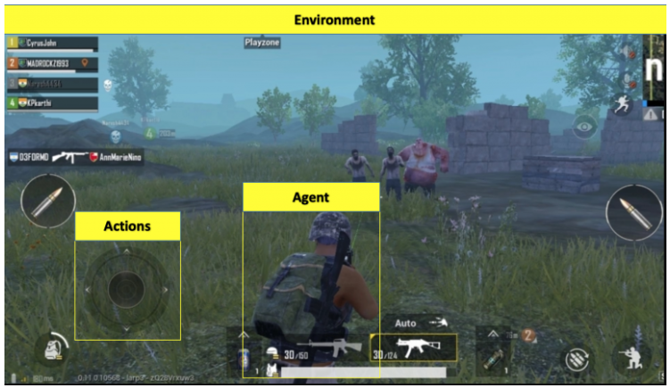
RL Agent-Environment
The soldier is the agent here interacting with the environment
The states are exactly what we see on the screen
An episode is a complete game
The actions are moving forward, backward, left, right, jump, duck, shoot, etc.
Rewards are defined on the basis of the outcome of these actions. If the soldier is able to kill an enemy, that calls for a positive reward while getting shot by an enemy is a negative reward.

Slide 8
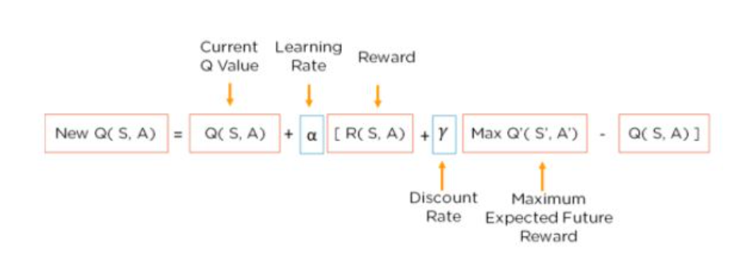
Use of Bellman Equation in Q Learning
The Bellman Equation is used to determine the value of a particular state and deduce how good it is to be in/take that state. The optimal state will give us the highest optimal value.
It uses the current state, and the reward associated with that state, along with the maximum expected reward and a discount rate, which determines its importance to the current state, to find the next state of our agent. The learning rate determines how fast or slow, the model will be learning.

Slide 9
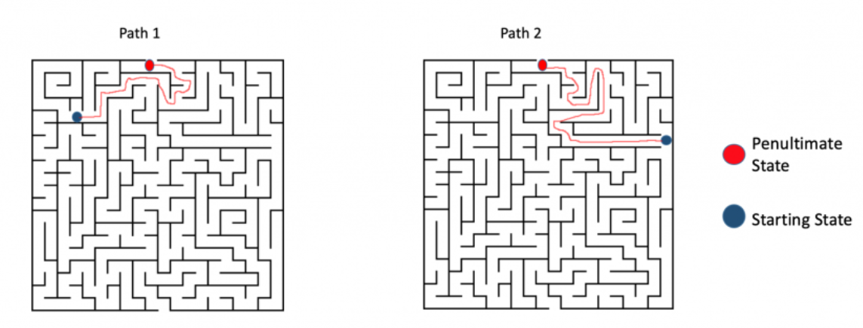
Use of Markov Decision Process (MDP)
An important point to note – each state within an environment is a consequence of its previous state which in turn is a result of its previous state. However, storing all this information, even for environments with short episodes, will become readily infeasible.
To resolve this, we assume that each state follows a Markov property, i.e., each state depends solely on the previous state and the transition from that state to the current state.

Slide 10
Important Terms in Q-Learning
States: The State, S, represents the current position of an agent in an environment.
Action: The Action, A, is the step taken by the agent when it is in a particular state.
Rewards: For every action, the agent will get a positive or negative reward.
Episodes: When an agent ends up in a terminating state and can’t take a new action.
Q-Values: Used to determine how good an Action, A, taken at a particular state, S, is. Q (A, S).
Temporal Difference: A formula used to find the Q-Value by using the value of current state and action and previous state and action.

Slide 11

Q learning concept
Let’s say we know the expected reward of each action at every step. This would essentially be like a cheat sheet for the agent! Our agent will know exactly which action to perform.
It will perform the sequence of actions that will eventually generate the maximum total reward. This total reward is also called the Q-value and we will formalise our strategy as:
The above equation states that the Q-value yielded from being at state s and performing action a is the immediate reward r(s,a) plus the highest Q-value possible from the next state s’. Gamma here is the discount factor which controls the contribution of rewards further in the future.
Q(s’,a) again depends on Q(s”,a) which will then have a coefficient of gamma squared. So, the Q-value depends on Q-values of future states as shown here:

Slide 12
Q learning concept
Adjusting the value of gamma will diminish or increase the contribution of future rewards.
Since this is a recursive equation, we can start with making arbitrary assumptions for all q-values. With experience, it will converge to the optimal policy. In practical situations, this is implemented as an update:
where alpha is the learning rate or step size. This simply determines to what extent newly acquired information overrides old information.

Slide 13
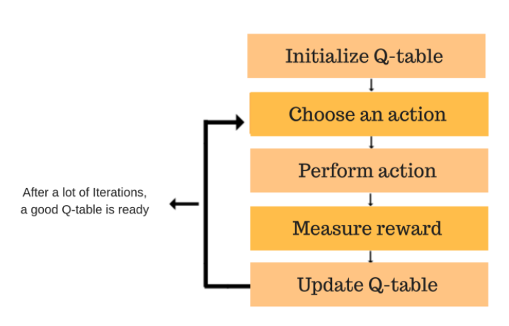
What’s a Q-Table?
A Q-Table helps us to find the best action for each state in the environment. We use the Bellman Equation at each state to get the expected future state and reward and save it in a table to compare with other states.

Slide 14
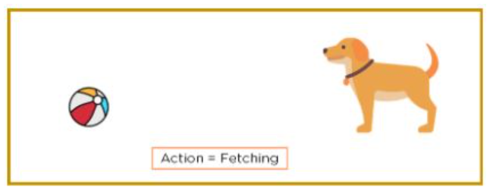
Example
Lets take an example –
Consider the image below. You can see a dog in a room that has to perform an action, which is fetching. The dog is the agent; the room is the environment it has to work in, and the action to be performed is fetching.

Slide 15
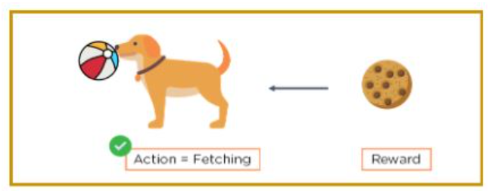
Example
If the correct action is performed, we will reward the agent. If it performs the wrong action, we will not give it any reward or give it a negative reward, like a scolding.

Slide 16
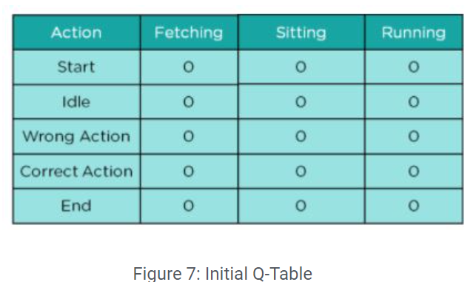
Steps to create Q-Table
Lets us create a q-table for an agent that has to learn to run, fetch and sit on command. The steps taken to construct a q-table are :
Step 1: Create an initial Q-Table with all values initialized to 0

Slide 17
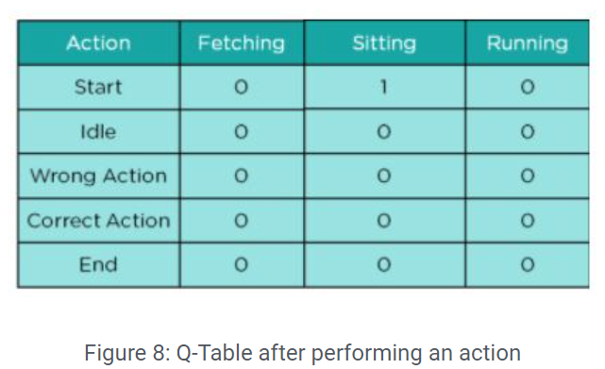
Steps to create Q-Table
Step 2: Choose an action and perform it. Update values in the table
This is the starting point. We have performed no other action as of yet. Let us say that we want the agent to sit initially, which it does. The table will change to:

Slide 18
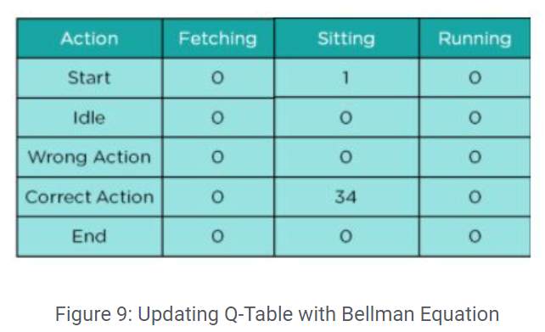
Steps to create Q-Table
Step 3: Get the value of the reward and calculate the Q-Value using Bellman Equation
For the action performed, we need to calculate the value of the actual reward and the Q(S, A) value

Slide 19
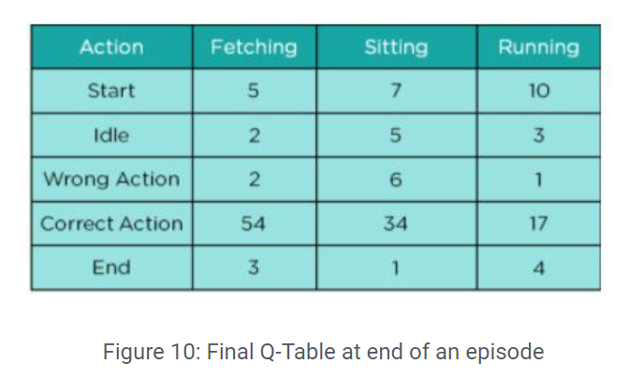
Steps to create Q-Table
Step 4: Continue the same until the table is filled or an episode ends
The agent continues taking actions and for each action, the reward and Q-value are calculated and it updates the table.

Slide 20
Steps to create Q-Table
Step 4: Continue the same until the table is filled or an episode ends
The agent continues taking actions and for each action, the reward and Q-value are calculated and it updates the table.

Slide 21
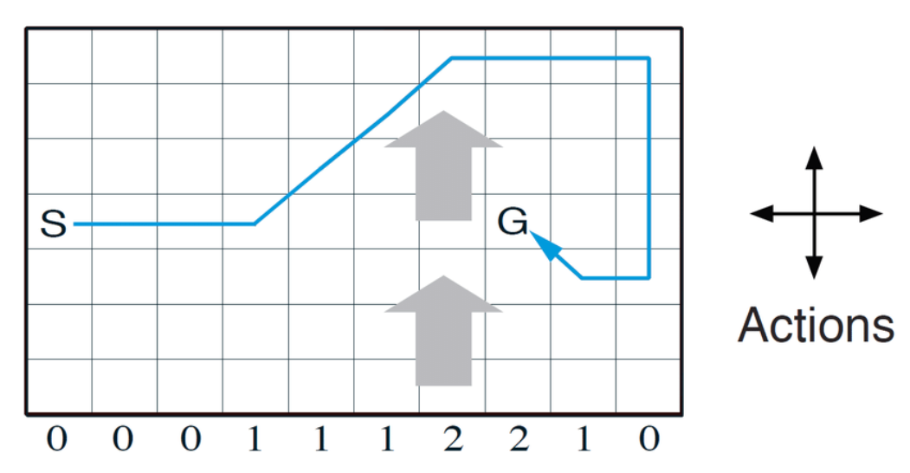
Implementation using python
Windy Grid World

Slide 22
References
An introduction to Q-Learning: Reinforcement Learning (floydhub.com)
What is Q-Learning: Everything you Need to Know | Simplilearn
Q-Learning in Python – GeeksforGeeks
An introduction to Q-Learning: reinforcement
Simple Reinforcement Learning: Q-learning | by Andre Violante | Towards Data Sciencet learning (freecodecamp.org)
Deep Q-Learning | An Introduction To Deep Reinforcement Learning (analyticsvidhya.com)

